Slide 1

CLIQUE – A Renaissance of Convenience

Slide 2








WAIŪ : Mission, Vision & Values
Mission:
To create a global service provider of hospitality industry, realizing pioneering advancements in established services and accomplish mutual growth for both our partners & customers
Vision:
WAIŪ is dedicated to provide modern & innovative solutions to our hospitality partners, via introduction of technology evolution in their offerings and creating avenues of inspiring new business horizons.
Values:
Innovation through Leadership : To become vanguard of hospitality experience enrichment
Modernization & Elegance : To develop ultramodern hospitality business solutions
Focus & Evolution : Relentlessly strive to improve business value through performance

Slide 3



Clique – The Opportunity
Clique is premium service offered to our finest customers & business partners, to mutually benefit from each other through means of microfinancing services.
Clique will be a unique solution focused on hospitality industry, which has been consistently growing & creating pristine opportunities for restaurants & it growing youthful consumer base.
Clique is designed to promote inclusive growth in hospitality industry by introducing flexible borrowing as channel partners, while simultaneously allowing ease of doing business and comfortable provisions.
With microfinance market anticipated to grow with CAGR of 40% through 2025, NBFC-MFIs will be its greatest beneficiaries. In F&B segment, unbanked microlending has only reached 12-15% of the prospective market.

Slide 4
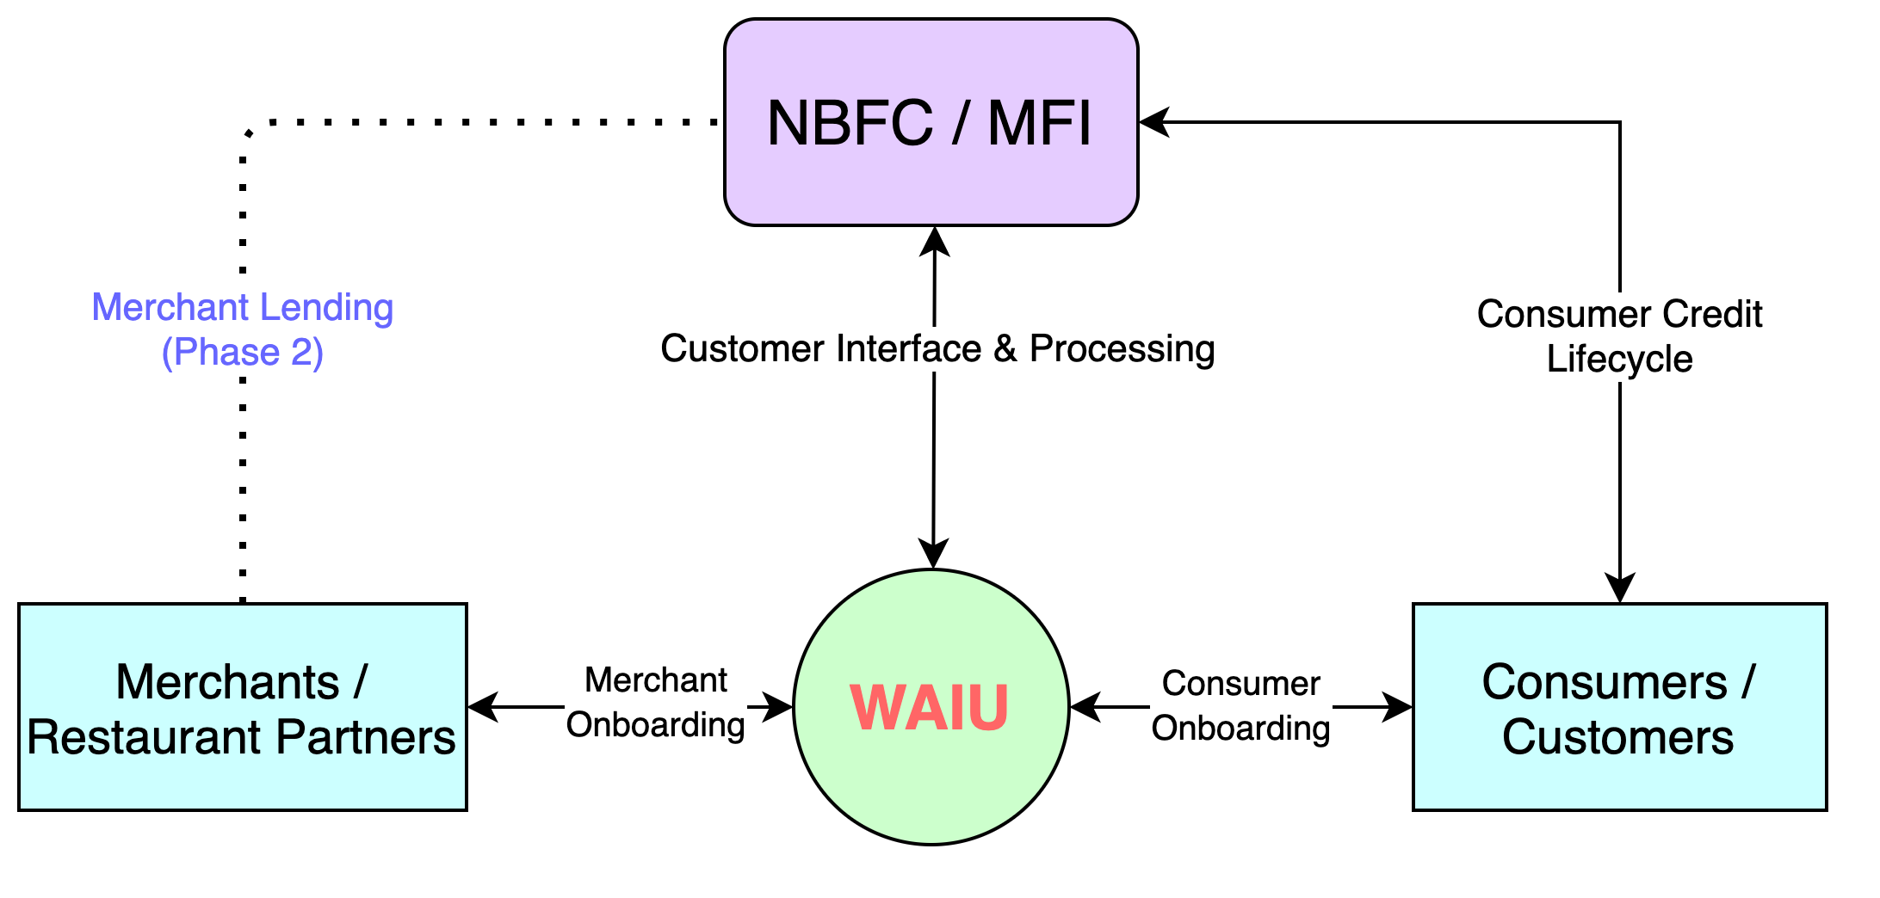
Clique – High Level System Flow
CASE STUDIES
Zomato, in partnership with InCred, to lend Rs 1L to 50k restaurants, developing loan book of 500CR
PAYO (Australia) – Launched ENPL service in July-21 & already has 500+ restaurant partners

Slide 5
Clique – 360° Benefits
Eat now, Pay Later
Consumers | Restaurants | MFI-NBFC
Increase in spend potential | Increased sales | New customers
Bio-authorization to reduce risks | Higher ticket size | Increased presence
No joining or renewal fees | New feature to offer | Competitive edge
Decorum & savings | No additional charges | Innovative offer
Microfinancing
Consumers | Restaurants | MFI-NBFC
Increased borrowing potential | Self-sufficiency at competitive rates | Untapped market – Millennials, Zoomers
Enhanced financial literacy | Standardized & organized system | Inclusive growth
Reactive credit scoring | Reduced regulatory challenges | Valued partnership
Better rates than banks | Co-branding opportunities | Benefit from geographic expansions

Slide 6
Clique - Year on Year Commercial Projections

Slide 7
Customer Acquisition Strategy
Merchant Acquisition Strategy | Consumer Acquisition Strategy | Notes
Direct sales via dedicated regional teams (10 per location per month) | WAIU direct acquisition (6-8k per location per month) | WAIU service acquisitions
Corporate collaborations with multi-location hospitality brands | Aggregation based model to increase time to market | To enable increased time to market
Pre/Post launch promotional & marketing campaigns | Social media & network advertisements | Combination of digital & traditional strategies
Network tie-ups and contact center for customer servicing | Event tie-ups e.g., Ridermania, Ruggedian

Slide 8
Case Studies
Company / Particular | Dineout | Magicpin | Eazydiner | Devourin
Founded | 2012, Noida | 2015, Gurgaon | 2014, Delhi | 2015, Pune
Owner | Times | Self | Self | Self
Services | Booking, Rewards, Payments, Artists | Discovery, Rewards | Discovery, Payment, Rewards | POS, SCM, Data Analytics, CRM
Coverage | 20 Cities | 40 Cities | 150 Cities | 2 Cities
Acquisition Restaurant/Customers | 50K /2.5CR | 1.5L /50L | 10K/30L | 200 / None
Investments | $100MN (2019) | $43M (2021) | $16M (2020) | $150K (2016)
Revenue | $200M | $10M | $42M | $500K
YoY Growth | 154% (2019) | 415% (2018) | 400% (2019) | TBC
Valuation | TBC | $165M | $40M | $1M

Slide 9
Project Plan – 6 Waves
Phase 06
April 2025
Expand in existing 10 Cities & explore additional scope
Target 3600 FL3 & 3.6 Lacs FL4 Customers in Each City
3600 FL3
36Lacs FL4
3000 FL3
30 Lacs FL4
Phase 05
October 2024
Expand in existing 10 Cities & explore additional scope
Target 3000 FL3 & 3 Lacs FL4 Customers in Each City
Phase 04
April 2024
Expand in existing 10 Cities & explore additional scope
Target 2400 FL3 & 2.4 Lacs FL4 Customers in Each City
2400 FL3
24 Lacs FL4
1800 FL3
18 Lacs FL4
Phase 03
October 2023
Expand in existing 10 Cities & explore additional scope
Target 1800 FL3 & 1.8 Lacs FL4 Customers in Each City
Phase 02
April 2023
Expand in existing 10 Cities & explore additional scope
Target 1200 FL3 & 1.2 L acs FL4 Customers in Each City
1200 FL3
12Lacs FL4
Phase 01
October 2022
Launch in 10 Cities
Target 600 FL3 & 60 thousand FL4 Customers in Each City
Company Registration : July 2020 - Complete
MVP PoC : Dec 2021
Foundation Period : Dec-21 to May
RBI Approval & Launch : May 2022 (Wave 1)

Slide 10
Our Team – In-Progress
Rajesh Karandikar – Founder & Owner, Hotel 24K Restaurant Network
Alok Sambuddha – Engineering Director, American Express (ex. Technology Leader – Infosys, ATOS)
Rahul Renavikar – Managing Director, Acuris Advisors (GST & Government Policies) – Ex. Big 4 & Tata Motors
Suhas Gokhale – Managing Director, COSMOS Bank, Pune
Shrikant Chatur – Governance Consultant (ex. VP Commercial - Cummins)
Shrikant Chepe – Technical Architect (Amway Head of Customer Solutions)
Rahul Patil – Security Specialist (Mastercard)
Chetan Oswal – Accounts & Legal Counsel
Partners:
IRSRD – Development, Governance, Technical Consultant, HR
KPMG – PPI Procurement Partner & Project Management
Sazinga Digital – Current Development Partner (Discussions ongoing with prominent vendors)

Slide 11






Question & Answers

